Slide 1
Final Project :ML Classification-News Prediction(Fake or Real)
IBM Machine Learning Profession Certificate
By Sadhana Jarag

Slide 2
Content
Dataset Description
Main Objective of Analysis
Applying various Classification models
Machine learning analysis and findings
Model Flaws and advance step

Slide 3
Data Description Section

Slide 4
Introduction :
"Misinformation can feel like an insurmountable problem, something that only tech giants and social media platforms can solve. But actually, we can each take steps to help stop it spreading, and these actions will have a direct impact on our own communities, friends and family.” – Jen Thomas, Creative Producer
Why News are Important:
Without the news, people would only be able to find out what was happening by asking people who had first-hand knowledge. This would massively reduce the information people would have about the world around them. The fact the news allows people to get up-to-date accounts of recent events is a major reason why it is important.
Why Identifying Fake News Is Important:
It is important to be able to spot fake news because people can be easily mislead by anything the media or someone can say about a topic also they may receive a bias opinion on a topic than getting both sides of the story. News articles and Columnist create fake news to gain more supporters, to spread hoax and lies, or to have more people read there article. Fake news is able to turn people against each other and makes it harder to know what is true or was is false an example of this can be with the Pacific Northwest Tree Octopus story which was a fake news article and was a form of click bait. It also ties into history for example if people require research on something that happened years ago and they find news articles with wrong information and cite them as a source of factual information people will get confuse and believe it.

Slide 5
Project Introduction
In this project we have collect the data of news article with respect to their titles, authors and the summary kind of information as in text feature.
Here we are trying to identify the fake and real news from the given data.

Slide 6
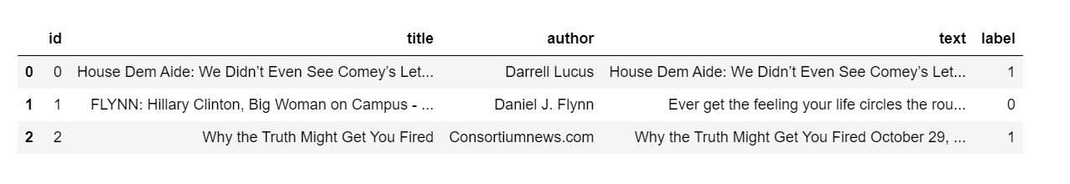
Dataset Description :Part 1

Slide 7
Dataset Description :Part 2
Data Description:
Here the data given is all about the news and we need to find out whether the data is fake or real.
We have four input feature and one output feature which is telling that data is real or fake.
Feature info:
1. id: unique id for a news article.
2. title: the title of the news article.
3. author: author of the news article.
4. text: the text of the article that could be incomplete.
5. label: a label that marks whether the news article is real or fake.
1 => fake news
0 => real news

Slide 8
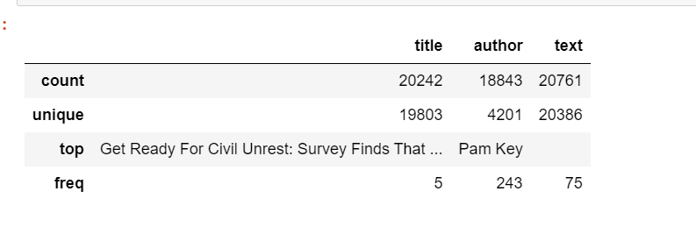
Dataset Description

Slide 9
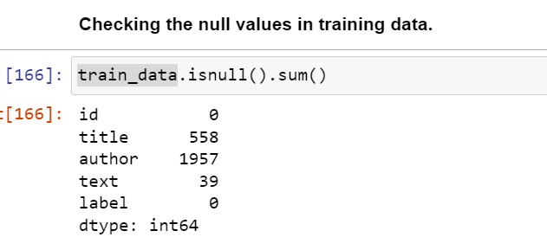

Dataset Description
Check for duplicate Value: No duplicate Value found
Check for Null Values : Null values are in the datasets

Slide 10
EDA :Exploratory Data Analysis

Slide 11
Main Objective of Analysis
In this section I am showing the analysis which I have done on the data and find out some patterns related to data with relation target feature.
After that I will apply different classification model and some hyperparameter tunning to get best predictive model in term of accuracy .
In addition I will suggest the what more work we can perform on the data also some flaws of the model.

Slide 12
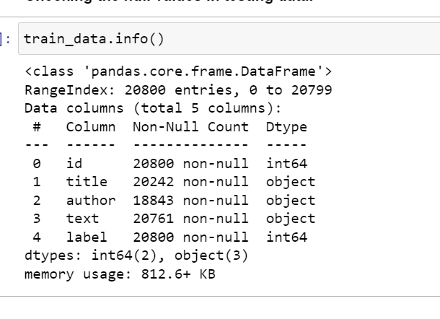
EDA :Exploratory Data Analysis
Numeric Feature : 2
Categorical Feature :3
Having Null values in Dataset
Total Feature :5
Input Feature :4
Output Feature :1

Slide 13
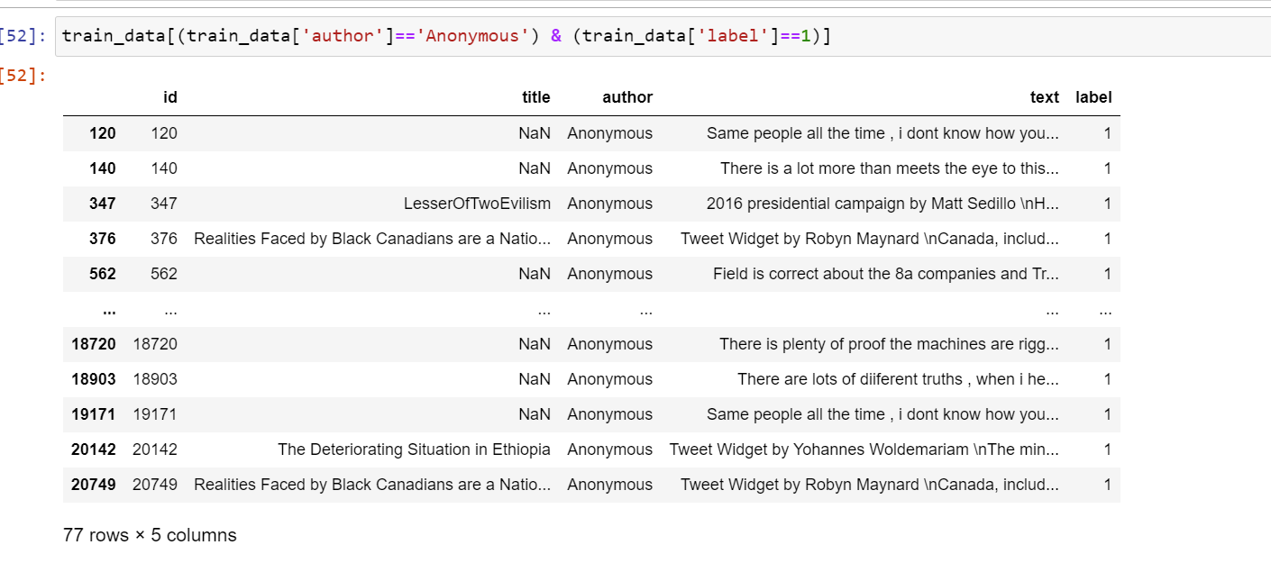
EDA :Exploratory Data Analysis
-Insights
Author with name ‘Anonymous’ having 77 rows in total and all are belong to category/label =1 means fake news.

Slide 14
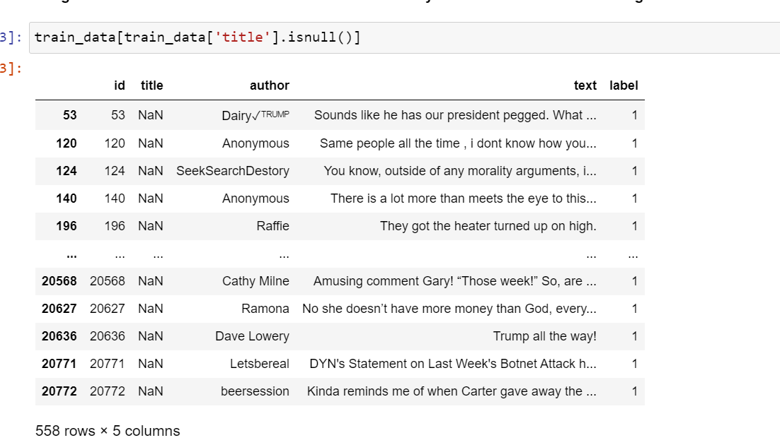
EDA :Exploratory Data Analysis
Insights : 558 rows with value ‘NaN’

Slide 15
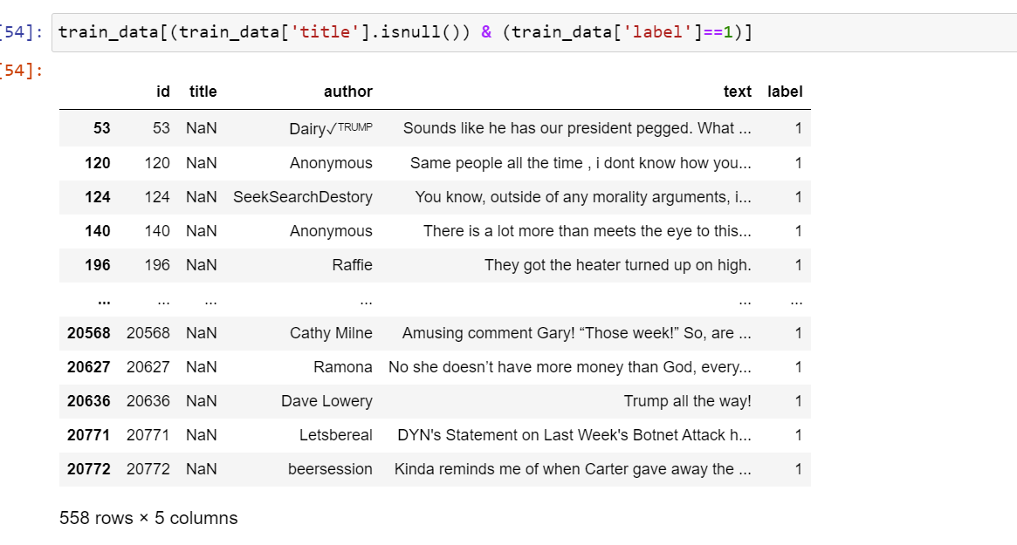
EDA :Exploratory Data Analysis
All values in the feature title with ‘NaN’ belongs to label 1 means fake news

Slide 16
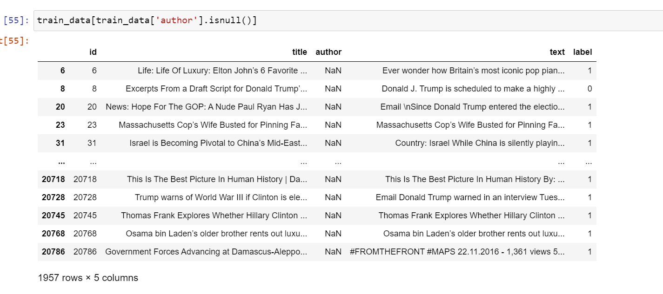
EDA :Exploratory Data Analysis
Insights :
We can observe the feature ‘author’ with NaN =1957

Slide 17
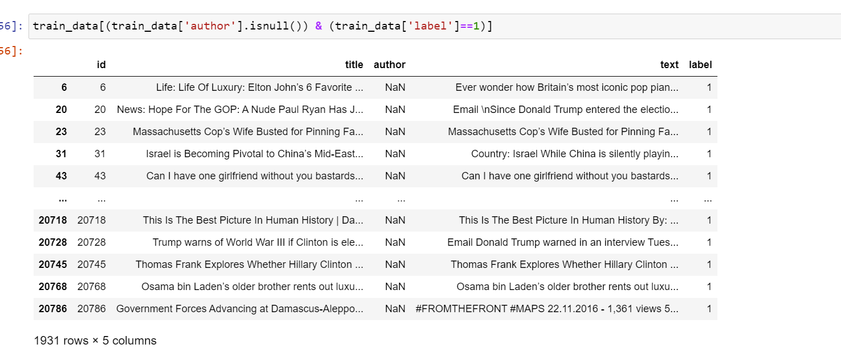
EDA :Exploratory Data Analysis
Out of 1957 we can see here 1931 values belong to label =1
means ‘Fake News’

Slide 18
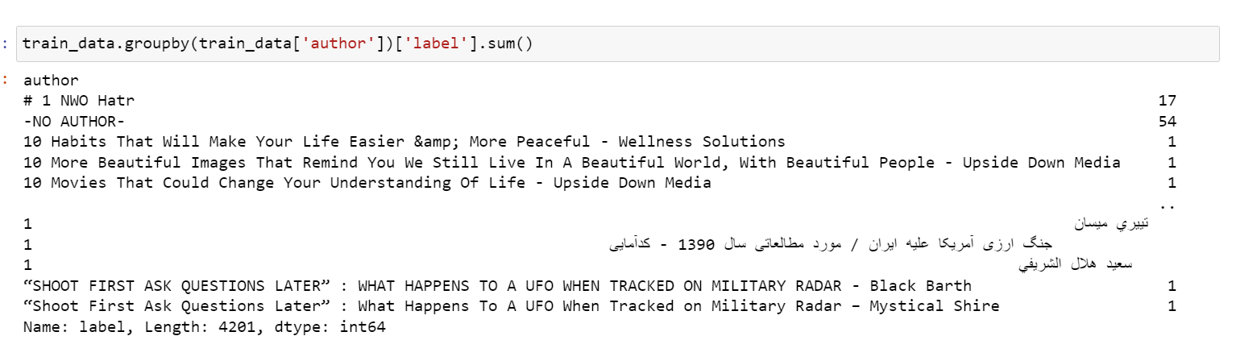
EDA :Exploratory Data Analysis
Here I just want to know how many authors are with the same label
We can see the result above

Slide 19
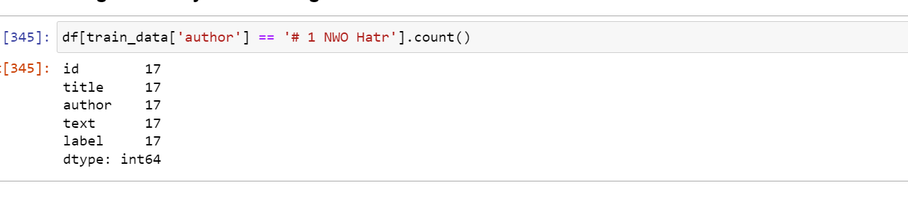
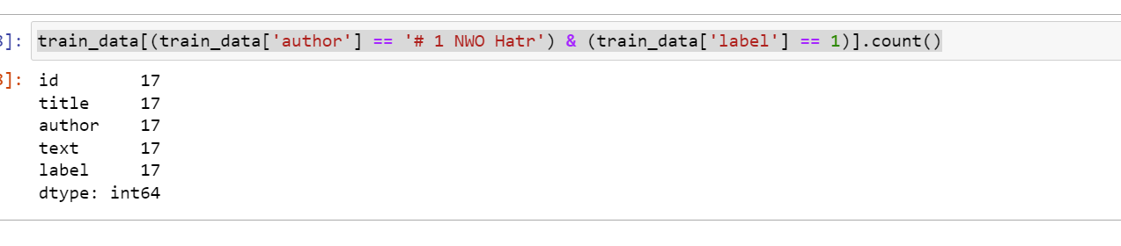
EDA :Exploratory Data Analysis
Insights :
We author with name “# 1 NOW Hatr “ with label 1 only.

Slide 20
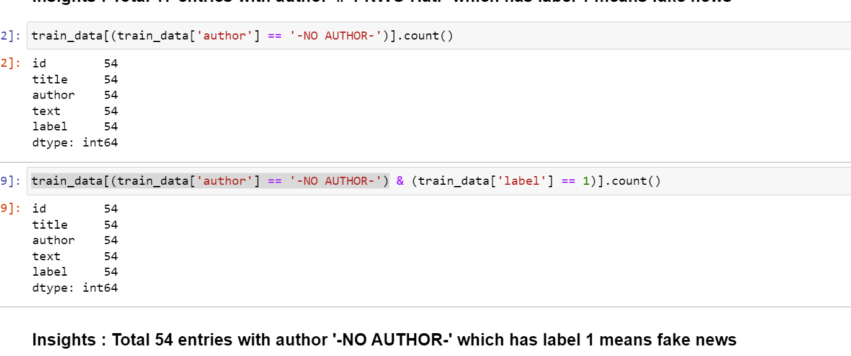
EDA :Exploratory Data Analysis

Slide 21
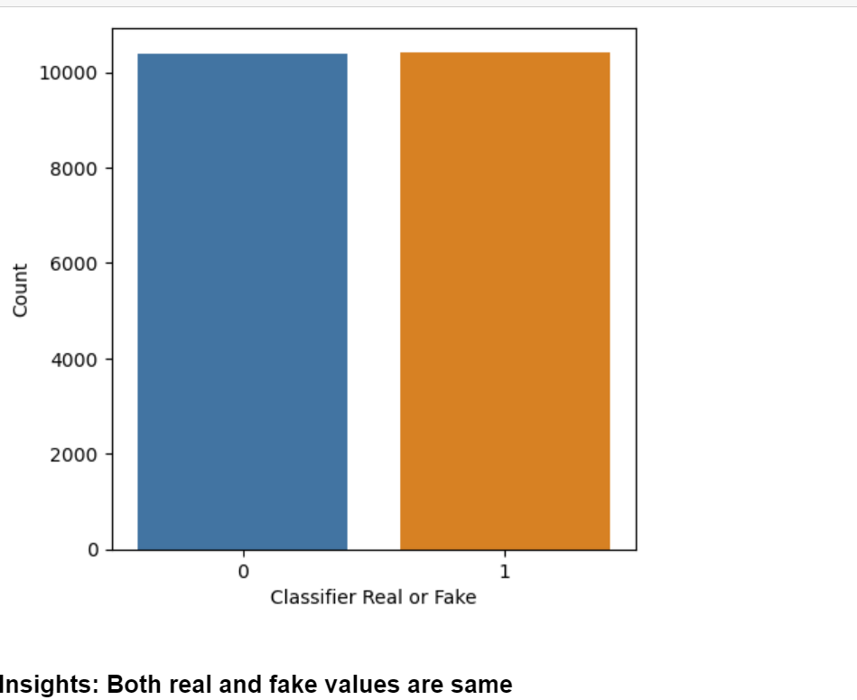
EDA :Exploratory Data Analysis
Here we can see data is balanced when we consider all values(missing and redundant)

Slide 22
FE : Feature Engineering

Slide 23
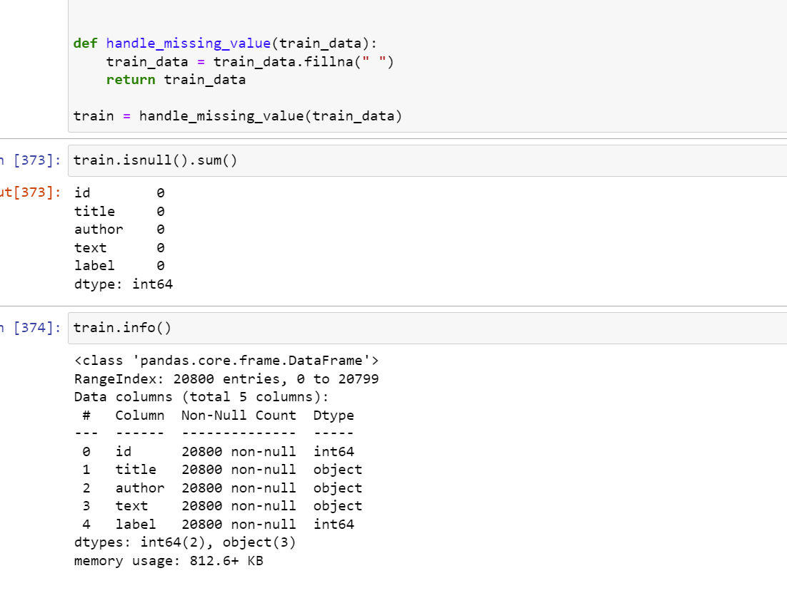
Feature Engineering
Here we fill all value with spaces

Slide 24
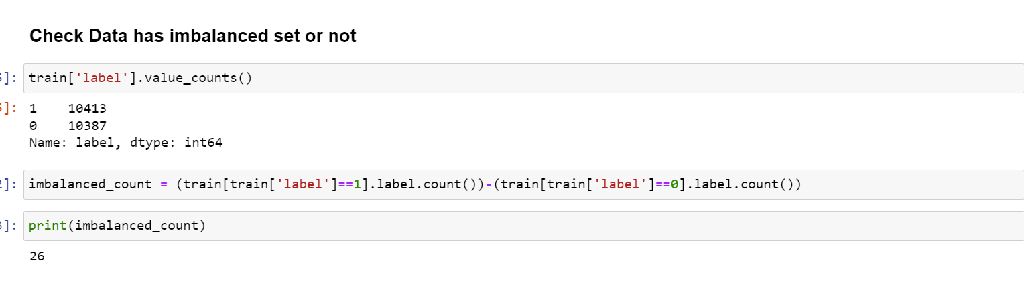
Feature Engineering
As we can see data is not much imbalanced but better to use stratified technique while doing train test split.

Slide 25
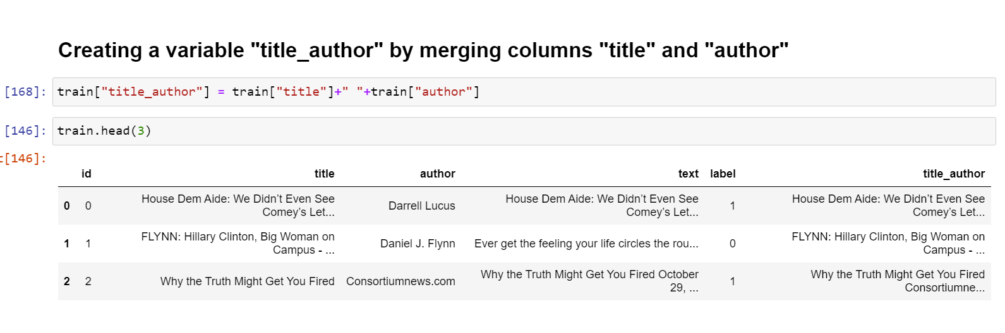
Feature Engineering
As we see there is more impact of title and author feature for choosing the label/target data so we merge into one cell.

Slide 26
Feature Engineering
Stemming and Data Cleaning
Stemming: This is the process of reducing the words into roots words and that will remove suffix and prefix from the word.
Steps are followed:
Firstly, all the sequences except English characters are removed from the string.
Next, to avoid false predictions or ambiguity with upper and lowercase, all the characters in strings are converted to lowercase.
Next, all the sentences are tokenized into words.
To facilitate fast processing, stemming is applied to the tokenized words.
Next, words are joined together and stored in the corpus.
Note: In this tutorial, we have used “title_author" column for classification task. Also, the loop inside the function runs over all the examples in the title_author column.

Slide 27
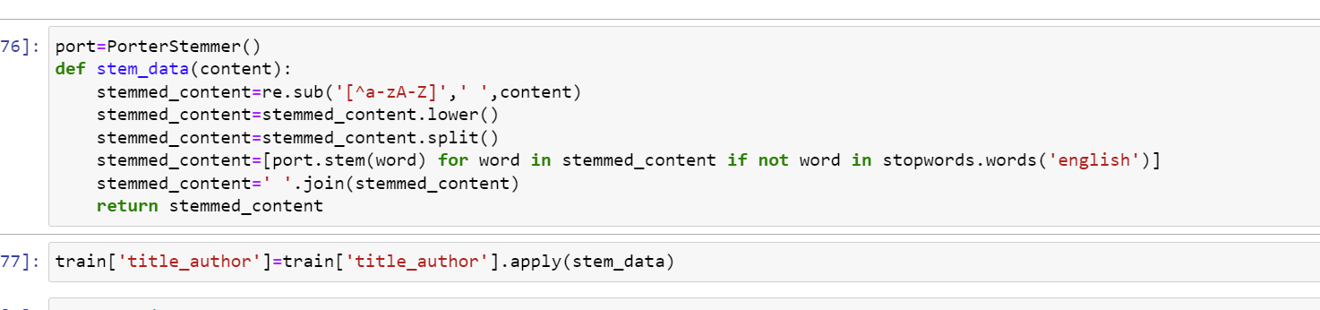
Feature Engineering

Slide 28
Machine Learning and Analysis
In the following analysis will compare between 4 different Classification model Logistic Regression, Naïve Bayes, Decision Tree and XGBoost in term of predicting the news whether its fake or real and as result obtained, we will decide whether we need to do hyperparameter tunning or not.
Here we are using CountVectorizer and TF-IDF vectorizer to convert the words/sentences into matrix.
In building a news detector, two intuitive considerations can be made to optimize the model accuracy. This model focuses on maximizing the vectorization of the input data set.
Using a countVectorizer for news dataset that have similar news articles. Intuitively, it means if more similar news article are found int the dataset, it is more likely these news article will be valid or false depending on the majority label.
The TFIDF works better in a dataset that has a lot of unique news article as it is able to highlight the weight of these unique words. Here I have done with both and get around similar accuracy.

Slide 29
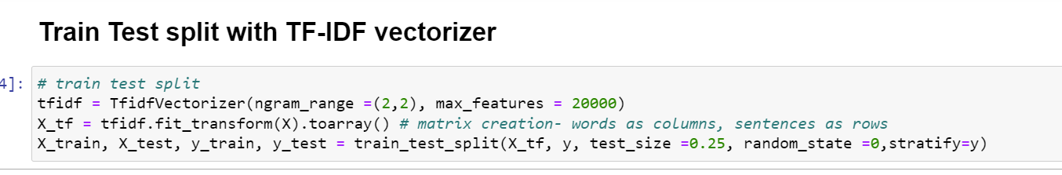
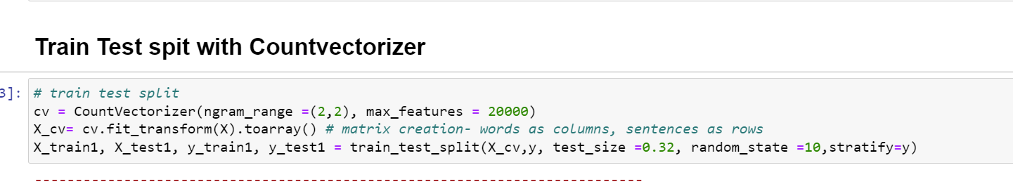
Data Spitting: I have done with analysis with both count vectorizer as well as with TF-IDF vectorization.

Slide 30
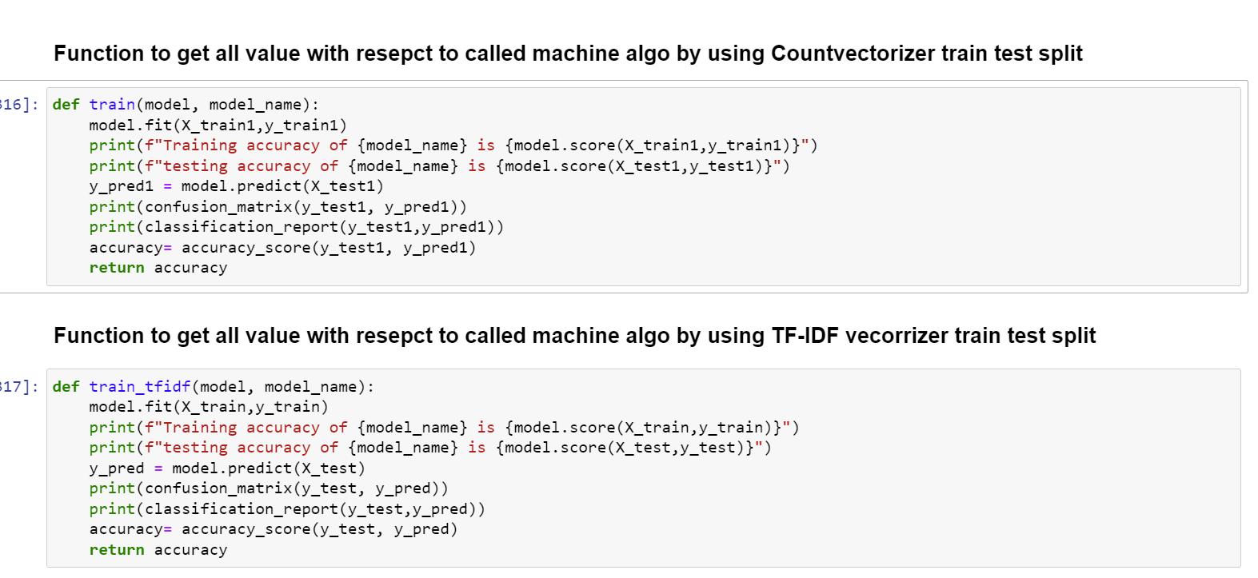
Model Evaluation Function

Slide 31
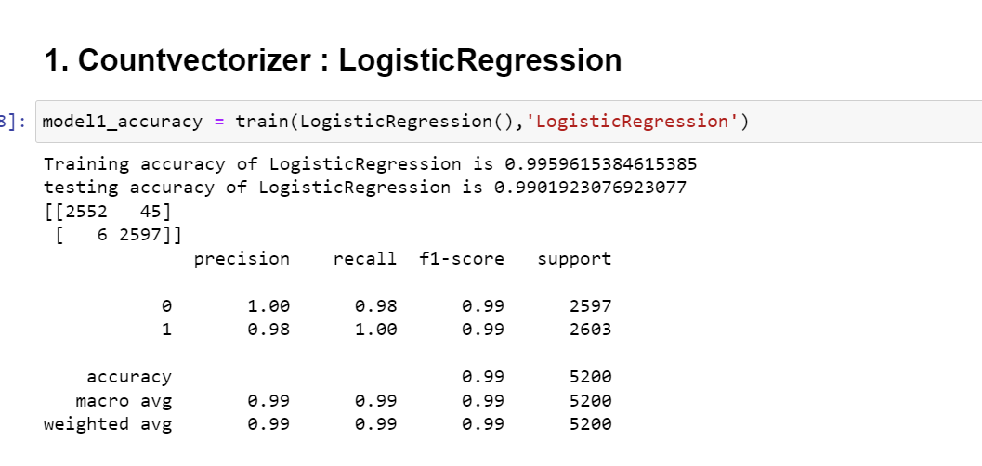
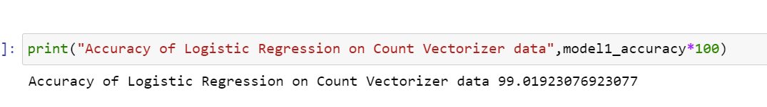
Model 1 :Logistic Regression Model

Slide 32
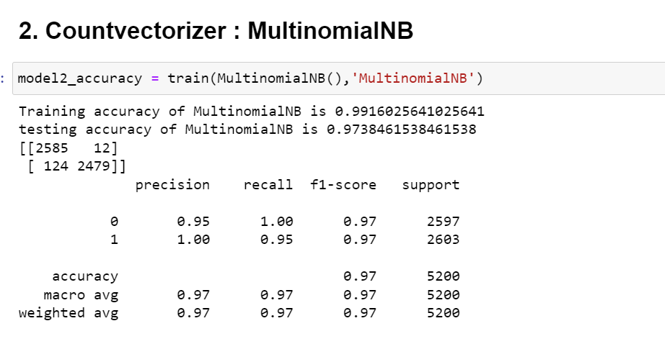
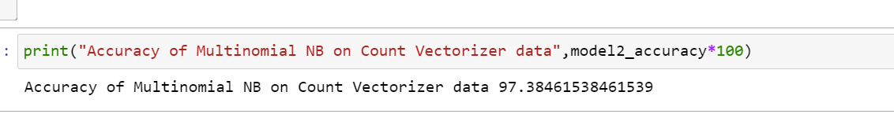
Model 2 : Naïve Bayes Model

Slide 33
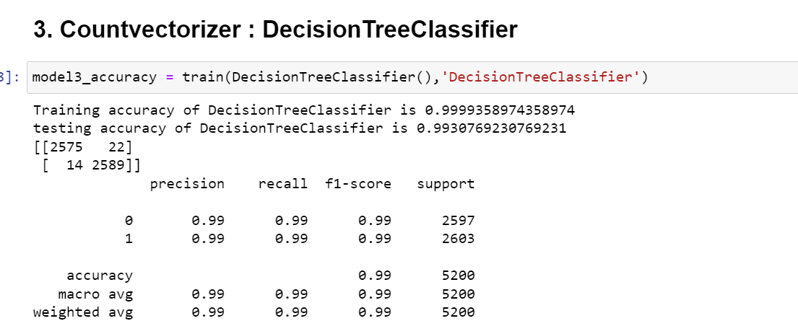
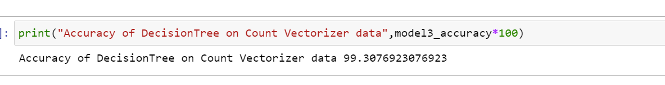
Model 3 :Decision Tree

Slide 34
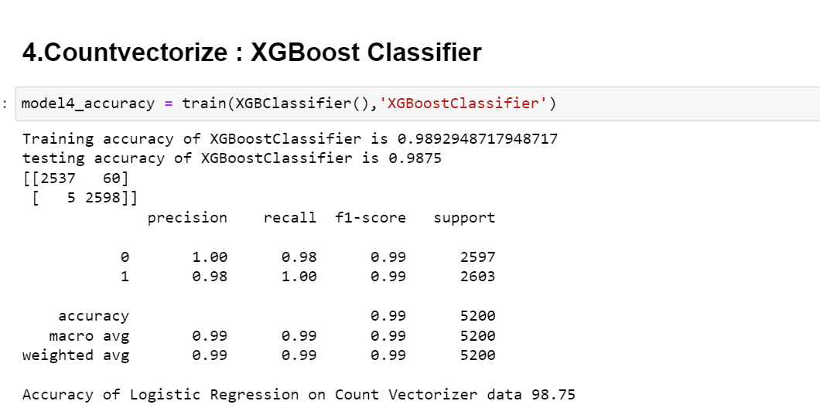
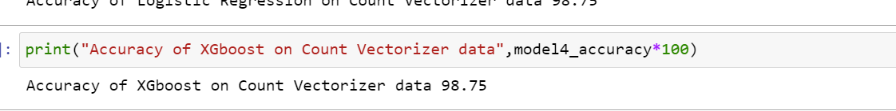
Model 4 :XGBoost Classifier

Slide 35
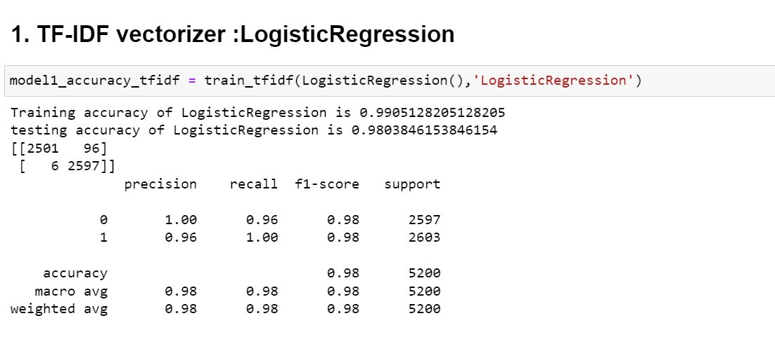
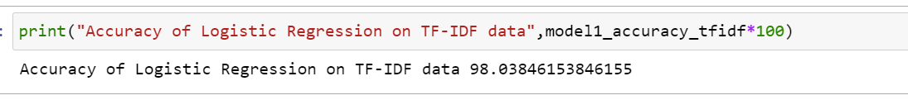
Model 5 :Logistic Regression with TF-IDF

Slide 36
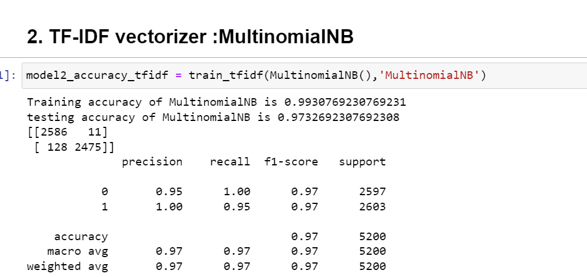
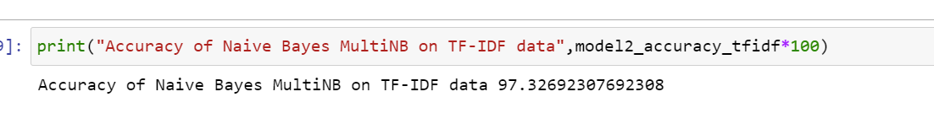
Model 6 :Naïve Bayes with TF-IDF

Slide 37
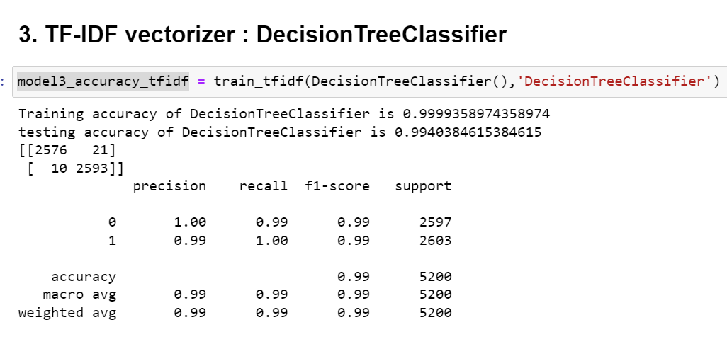
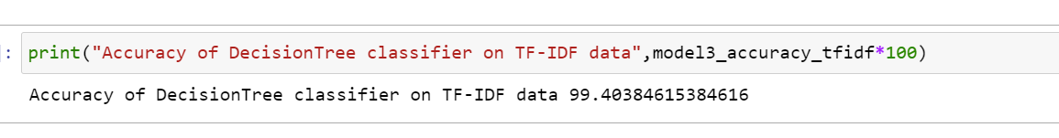
Model 7:DecisionTree with TF-IDF

Slide 38
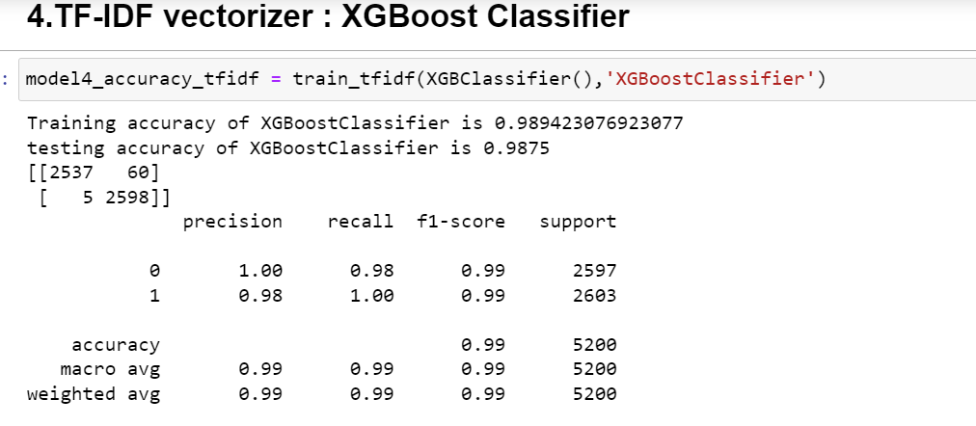
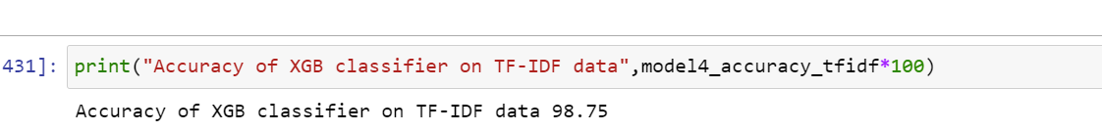
Model 8:XG Boost Classifier with TF-IDF

Slide 39
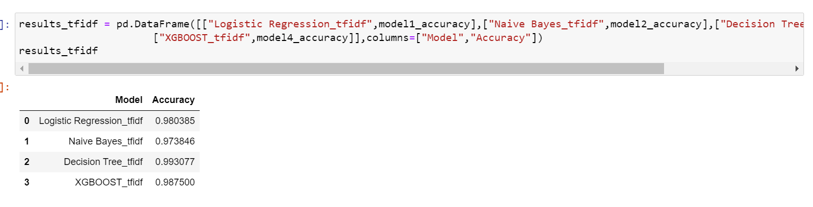
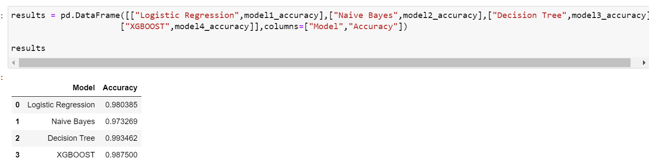
Model Accuracy of all model with split TF-IDF
Model Accuracy of all model with split Count Vectorizer

Slide 40
Model Comparison, Model Flaws ,Advanced Step and further Suggestion
Here is the analysis
All models are performed well so we need to check with respect to computational time, cost and memory consumption etc. to decide which one we can use.
In term of simplicity ,we can say that Logistic regression and Naïve Bayes provided high predictive result and at the same time they are simplest and fastest model of the parameter, but Decision tree provided the best result in case of Countvectorizer and TF-IDF vectorizer.
DecisionTree and Xgboost provided the very good result, but they took longer time to execute that means they need more time to train than other two algorithm.
Here in this dataset both vectors perform well as we see the Countvectorizer perform well that TF-IDF vectorizer but if we can see the long run basis it is good to use TF-IDF vectorizer.
At the end of the trade off if we have bigger dataset then there are chances of model can perform differently so in that case we have to use hyperparameter tunning for all the algorithm that we used here now or may be we have to try different machine algorithm to check the performance in compare with all these algorithm.
- You can fine the code at : sadhanajarag/IBM-Certification-Supervised-Machine-Algorithm (github.com)

Slide 41
Thank You!!!!
Supervised Machine Learning :Classification
By Sadhana Jarag

